Slide 1
Hereford Western Bypass
Flow Difference Plots

Slide 2
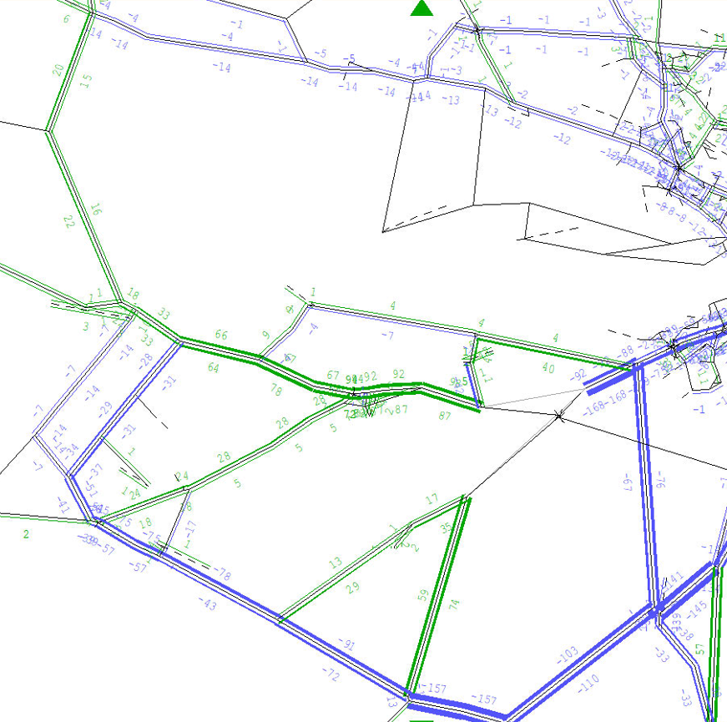
AM Peak - 2043
Bridge Sollers
Green = Increase
Blue = Decrease
Do Something (with Phase 1) vs Do Minimum (without)
Madley
Clehonger
B4352
B4349
B4348

Slide 3
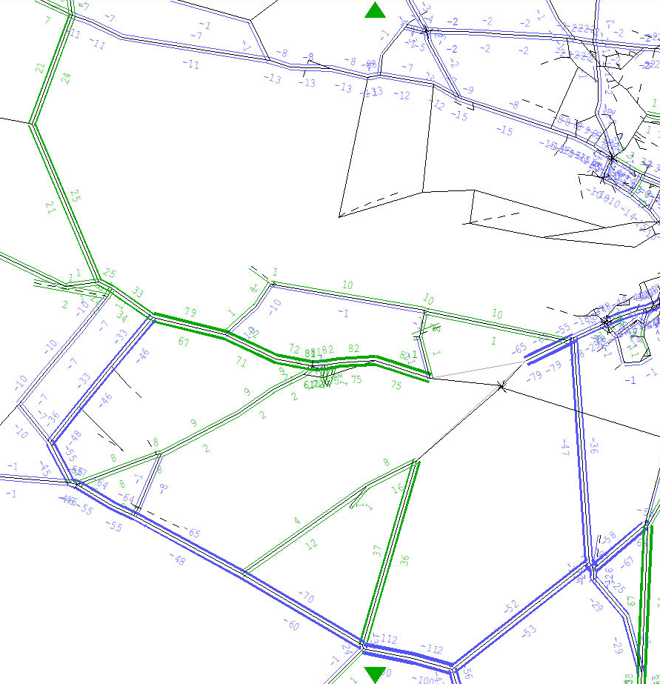
IP - 2043
Bridge Sollers
Green = Increase
Blue = Decrease
Do Something (with Phase 1) vs Do Minimum (without)
Madley
Clehonger
B4352
B4349
B4348

Slide 4
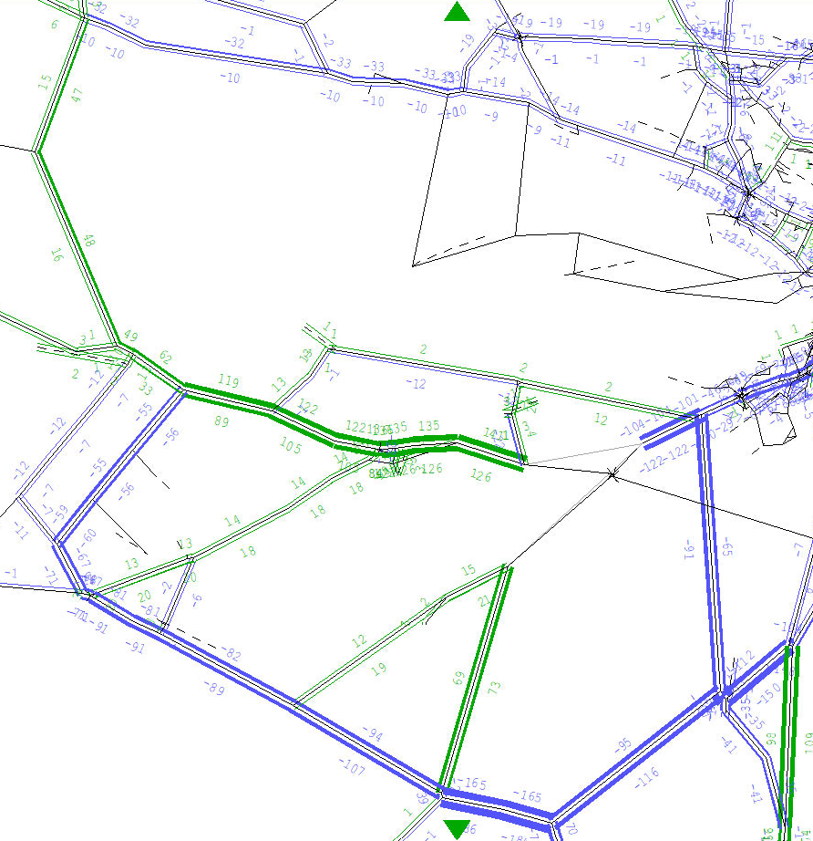
PM Peak - 2043
Bridge Sollers
Green = Increase
Blue = Decrease
Do Something (with Phase 1) vs Do Minimum (without)
Madley
Clehonger
B4352
B4349
B4348

